Slide 1

Marketing Campaign Analysis Report
By
Anusha Narapareddy

Slide 2






TABLE OF CONTENT
Project Overview
Data Manipulation
Introduction
Insights
Objectives
Analysis Report
Data Sets
Recommended Analysis
Tools
Recommendations

Slide 3
PROJECT OVERVIEW

Slide 4
PROJECT
Project : Marketing Campaign Analysis
Data Source : Sports_Campaign_Data
Presented By : Anusha N

Slide 5

INTRODUCTION
This Analysis focuses on Customer Behaviour, Customer Journey & Engagement, Rating Sentiment, Product Analysis and Campaign Performance using Power BI Reports.
The goal is to improve Marketing outcomes by identifying Key Metrics, Trends, and Conversion barriers.

Slide 6
OBJECTIVES
Measure and Compare Customer Engagement Rates by Demographics and Content Types.
Analyse Customer Lifetime Value (CLV) and Sentiment distribution.
Monitor Conversion Rate and Drop-off Rate across Customer Journey Stages.
Evaluate Campaign Effectiveness and Product Performance.
To enhance the Marketing Strategy.
To uncover the Actionable Insights.

Slide 7
DATA SET
Tables Used:
Customers
Customer_Journey
Cust_Review
Engagement_Data
Products
Countries
Dataset Structure
Rows
(Customers : 100, Customer_Journey : 4011,
Cust_Review : 1363, Engagement_Data : 4623,
Products : 20, Countries : 10)
Columns
(Customers : 6, Customer_Journey : 7,
Cust_Review : 6, Engagement_Data : 8,
Products : 4, Countries : 3)

Slide 8
TOOLS
Power BI : For Reports, Dashboards and Visualizations
Power Query : For Data Cleaning and Transformation
DAX : For Calculated Columns and Measures
Microsoft Power Point : For Presentation

Slide 9
DATA MANIPULATION
Key Measures Created:
Conversion_Rate = (Purchased & Checkout / Total Visits)
Dropoff_Rate = (Dropoffs Total Visits)
Engagement_Rate = (Total Likes / Total Clicks)
Click_Through_Rate = (Total Clicks / Total Views)
CLV = SUM(Purchase Value per Customer)
Filters Applied:
Date Filter
(01-Jan-2023 to 31-Dec-2025)
Slicers
Age Group, Gender,
Country, Content Type,
CampaignID, Stage,
Rating_Sentiment

Slide 10
INSIGHTS

Slide 11
INSIGHTS
Insights:
Conversion Rate
Drop-off Rate
Engagement Rate
Customer Lifetime Value (CLV)
Click-Through Rate (CTR)
Sentiment Analysis
Key Metrics:
Total_Reviews : 1,363
Conversion_Rate : 4.99%
Engagement_Rate : 22.97%
Dropoff_Rate : 15.28%
Average Rating : 3.69
Click-Through Rate (CTR) : 19.57%

Slide 12
VISUALIZATIONS
Marketing Analysis Summary Report
Total_Reviews : 1363
Conversion_Rate : 4.99%
Dropoff_Rate : 15.28%
Engagement_Rate : 22.97%
Average Rating : 3.69
Click-Through Rate : 19.57%
Visualizations:
Map : Customers by Countries
Stacked Column Chart : CLV by Age Group
Stacked Bar Chart : Rating_Sentiment by Age_Group
Pie Chart : Engagement_Rate by ContentType
Line Chart : YTD_Engagement by Year
Scroller : Total Percentage of Customer Actions

Slide 13
Customer & Country Analysis
Visualizations:
Table : CLV of each Customer
Stacked Column Chart : CLV by Age Group
Pie Chart : Revenue share by each Country
Scroller : Total Customers in each Country
Gauge Chart : No. of Customers and Purchases
Filters : Gender, Country Filters

Slide 14
Customer Journey Analysis
Visualizations:
Donut Chart : Gender wise Engagement Rate
Pie Chart : Gender wise Conversion Rate & Dropoff Rate
Line Charts : Age_Group wise Conversion Rate & Dropoff Rate
Funnel : Dropoff Rate by Stage
Filters : Age_Group, Gender, Stage Filters Enabled

Slide 15
Engagement Analysis
Visualizations:
Donut Chart : Engagement Rate by ContentType
Pie & Column Chart : Engagement_Rate & Revenue by ContentType
Clustered Column Chart : Top 5 Campaigns with Engagement_Rate
Filters : ContentType Filter Enabled
Metric Cards : YTD Engagement, SPLY_Engagement, CTR

Slide 16
Rating_Sentiment Analysis
Visualizations:
Table : Average Rating of Each Product
Word Cloud : Reviews of Customers
Clustered Column Chart : Rating_Sentiment by Age_Group
Scroller : Top 5 Rated Products
Gauge Chart : Total No. of Ratings
Filter : Rating_Sentiment Category
Metric Cards : YTD Engagement, SPLY_Engagement, CTR

Slide 17
Product Analysis
Visualizations:
Metric Cards : Top 5 Products by Views, Likes, Rating, Engagement Rate
Cards : Product Count and Product Category
Table : Customer & Product Details
Filter : Rating_Sentiment Filter

Slide 18
ANALYSIS

Slide 19
ANALYSIS
Total_Reviews : 1363
Conversion_Rate : 4.99%
Dropoff_Rate : 15.28%
Engagement_Rate : 22.97%
Average Rating : 3.69
Click-Through Rate : 19.57%
Total No. of Customers = 100
Total No. of Products = 20
Total No. of Countries = 10
Total No. of Campaigns = 20
Total Revenue of all Countries = 823 K
Gender : 2 (Male, Female)
Age_Group : 4 (Below 25, 25 – 40, 41 – 60, Above 60)
Years of Campaign Data : 3 Years (2023, 2024, 2025)
Content Type : 4 (Video, Blog, Social Media, News Letter)
Rating : 5 (1, 2, 3, 4, 5)
Rating_Sentiment : 3 (Negative, Neutral, Positive)
Actions : 4 (Click, Drop-off, Purchase, View)
Stages : 3 (Checkout, Homepage, Productpage)

Slide 20
ANALYSIS
Customer & Country Analysis
Map showing customer distribution in 10 various European Countries.
Spain contributes the Highest number of Customers (18) and generates the Highest Revenue (160 K) among other countries indicating the Most profitable market in this campaign.
France contributes the Lowest number of Customers (5) and generates the Least
Revenue (44 K) among other countries indicating underperformance in this market campaign.
Female Customers have a Higher Customer Lifetime Value (CLV) compared to Male Customers.
Customers Aged 25–40 have the Highest Customer Lifetime Value (CLV) indicating Strong Engagement and Purchasing behavior.
While Customers Aged Below 25 and Above 60 show comparatively Least CLV.

Slide 21
Customer Journey Analysis
Among all the Customer Actions, Views are Higher and Purchases are Fewer.
The Conversion_Rate is High (5 %) among Female customers indicates the consistent Engagement to Purchase.
While the Drop-off_Rate is High (17 %) among Male customers, means they are more
likely to Exit before completing the Journey.
The Conversion_Rate is High among Aged 25–40 Customers, while Least among Above 60 Aged Customers.
This indicates that Middle-Aged Customers are more likely to complete Purchases.
The Drop-off_Rate is High among Customers Below 25 years.
While the Customers Aged Above 60 shows the Low Drop-off_Rate.
The Drop-off_Rate is significantly Higher (75 %) at the Checkout Stage compared to the Drop-off_Rate at Product page (2 %).

Slide 22
Engagement Analysis
Customer Engagement has shown a consistent Decline from year 2023 to 2025, indicating Reduced Interaction and Interest over time.
Among all the Content Types, Videos has the Highest Engagement Rate (26 %).
The Campaigns with Blog content generates the High Revenue (250 K), while Newsletters bring in Less Revenue (217 K) comparatively.
Campaign ID 15 has the Highest Engagement Rate, while Campaign ID 10 shows the Lowest, suggesting that Campaign Effectiveness varies and highlighting opportunities to learn from top-performing content.
Across Clicks, Likes, and Views,
Basketball consistently receives the Highest (259) Engagement,
whereas Surfboard shows the Lowest (209), highlighting Strong Customer Preference in
Basketball Products.

Slide 23
Rating Analysis
Customers Aged 25–40 provide the Highest number of Ratings reflecting Strong Engagement.
Whereas Customers Below 25 provides the Least number of Ratings.
Most of the Ratings & Reviews are Positive.
The Average Rating across all Products is 3, showing moderate overall Customer Satisfaction.
Positive Sentiments are the Highest among all Ratings, while Negative Sentiments are the Lowest among all the Ratings indicating that most Customers have a Favorable perception of the Products.
Customers Aged 25–40 show the Highest Rating sentiment, while those Above 60 have the Lowest suggesting that Middle-Aged Customers are more satisfied with their experience compared to Older customers.

Slide 24
Product Analysis
The Top 5 Rated Products are led by Ice Skates with 79 Ratings, followed by the Fitness Tracker with 76 ratings, Kayak with 75 Ratings, Soccer Ball with 75 Ratings, Swim Goggles with 73 Ratings indicating Strong Customer Satisfaction and Popularity in these categories.
The Least Rated Product is Cycling Helmet with 56 Ratings.
Ice Skates received the Highest (79) Customer Ratings, while the Yoga Mat has the Lowest (56) Ratings.
All marketing campaigns are exclusively focused on the Sports Category (20 Products), showing a clear strategy to promote Sports Products.
The Yoga Mat has the Highest Engagement_Rate, while the Fitness Tracker has the Lowest showing stronger Customer interaction with the Yoga Mat.

Slide 25
ANALYSIS REPORT

Slide 26
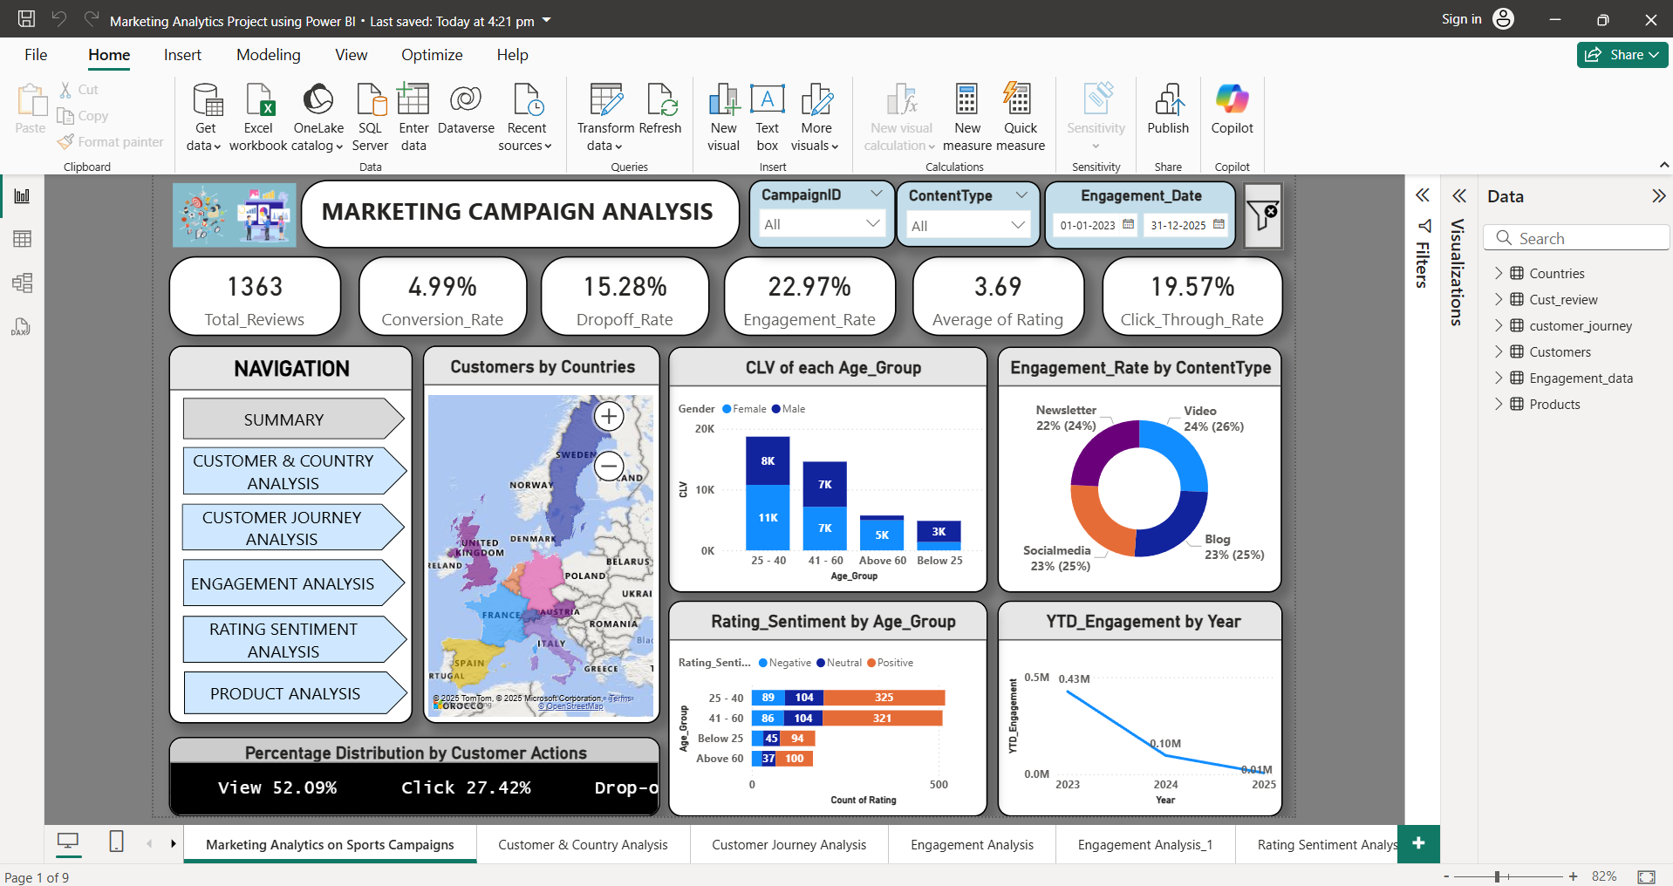
Marketing Campaign Analysis Report (Summary)

Slide 27
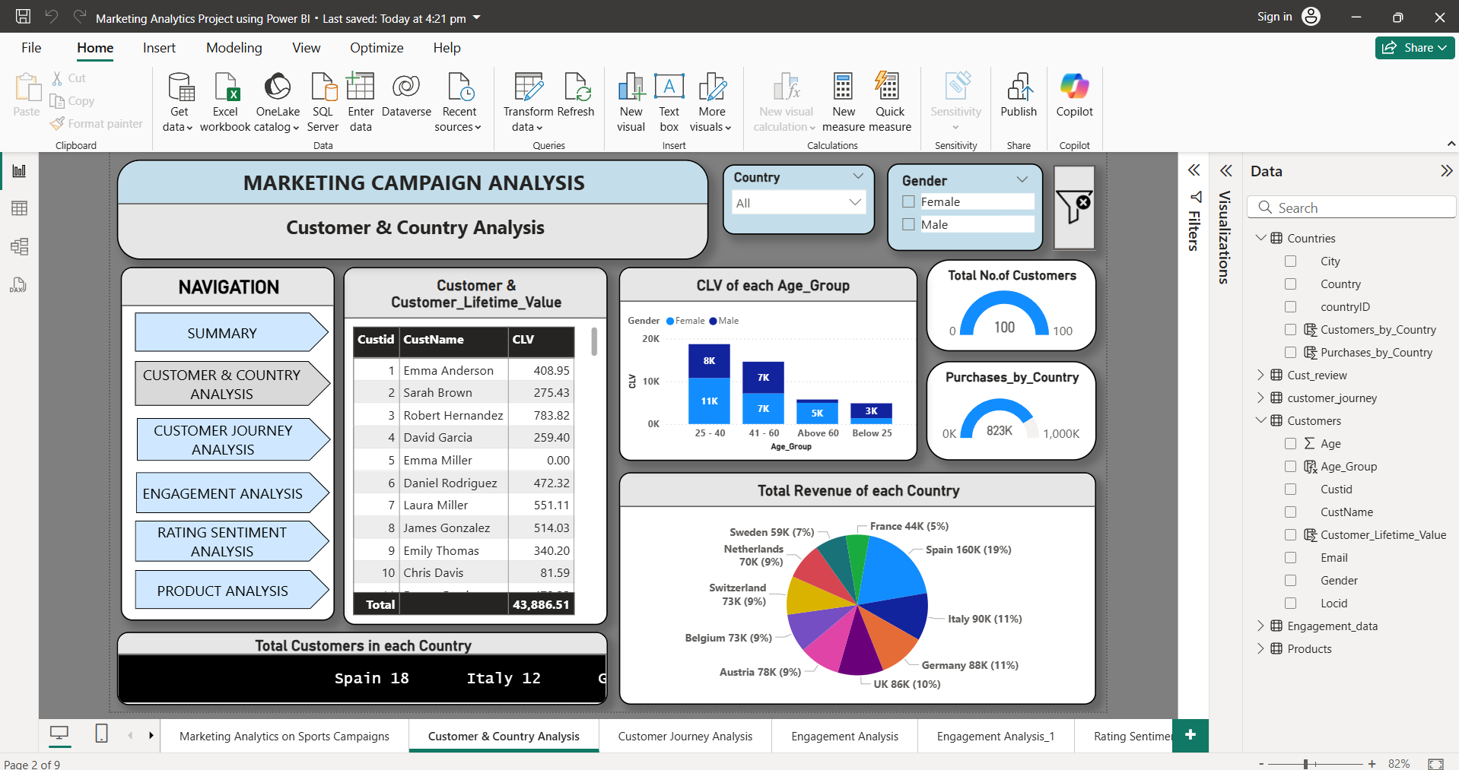
Customer & Country Analysis

Slide 28
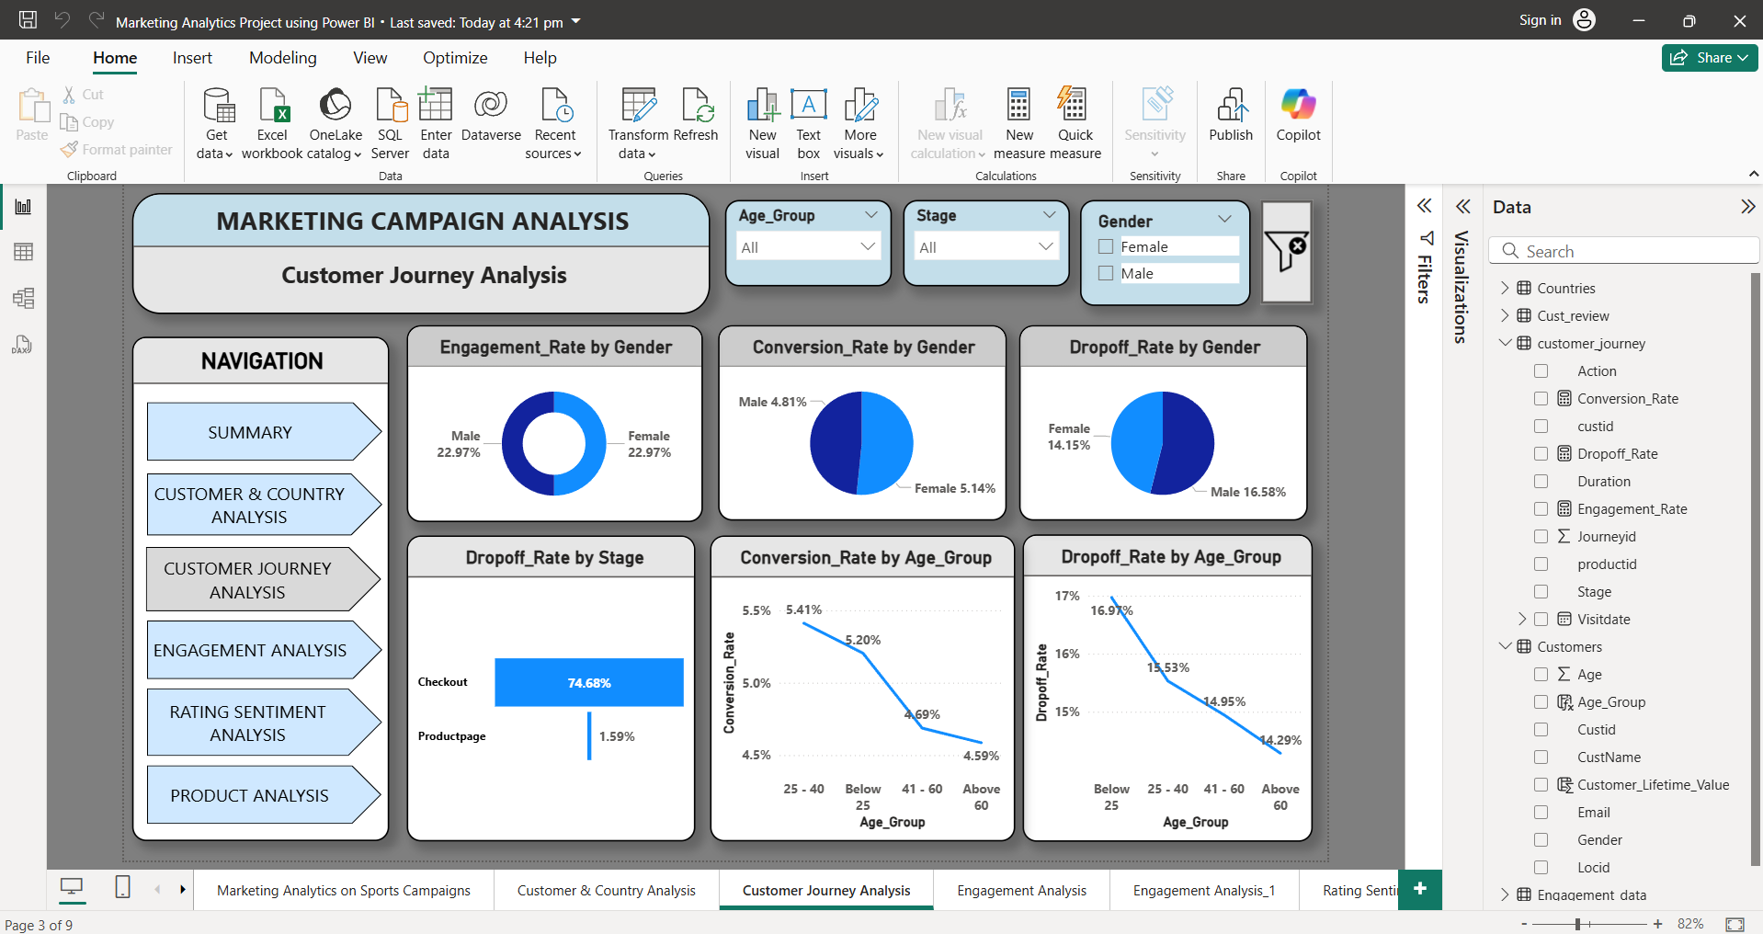
Customer Journey Analysis

Slide 29
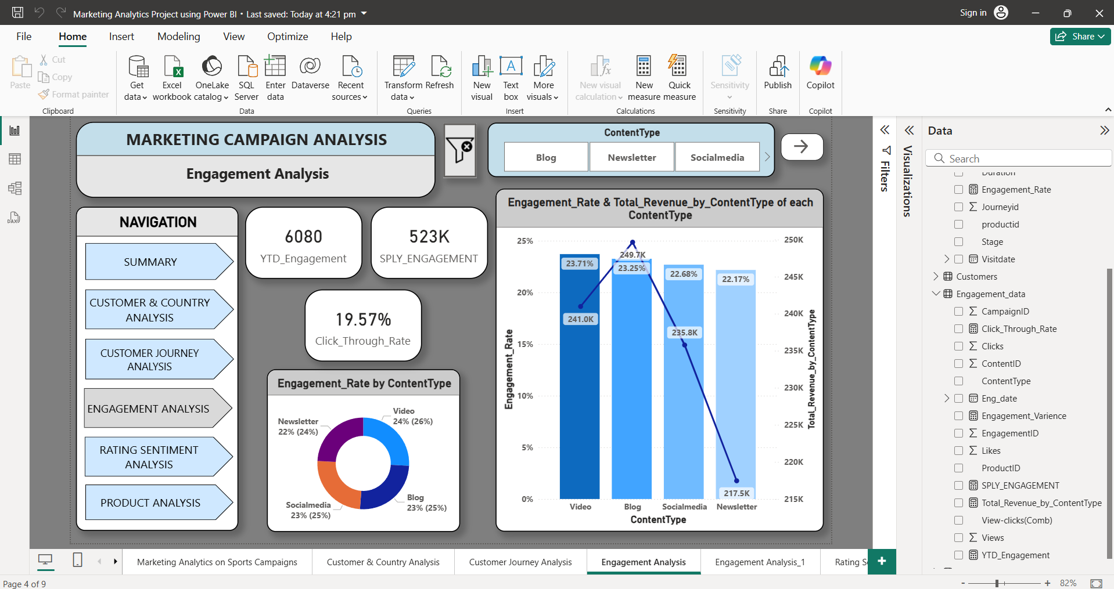
Engagement Analysis

Slide 30
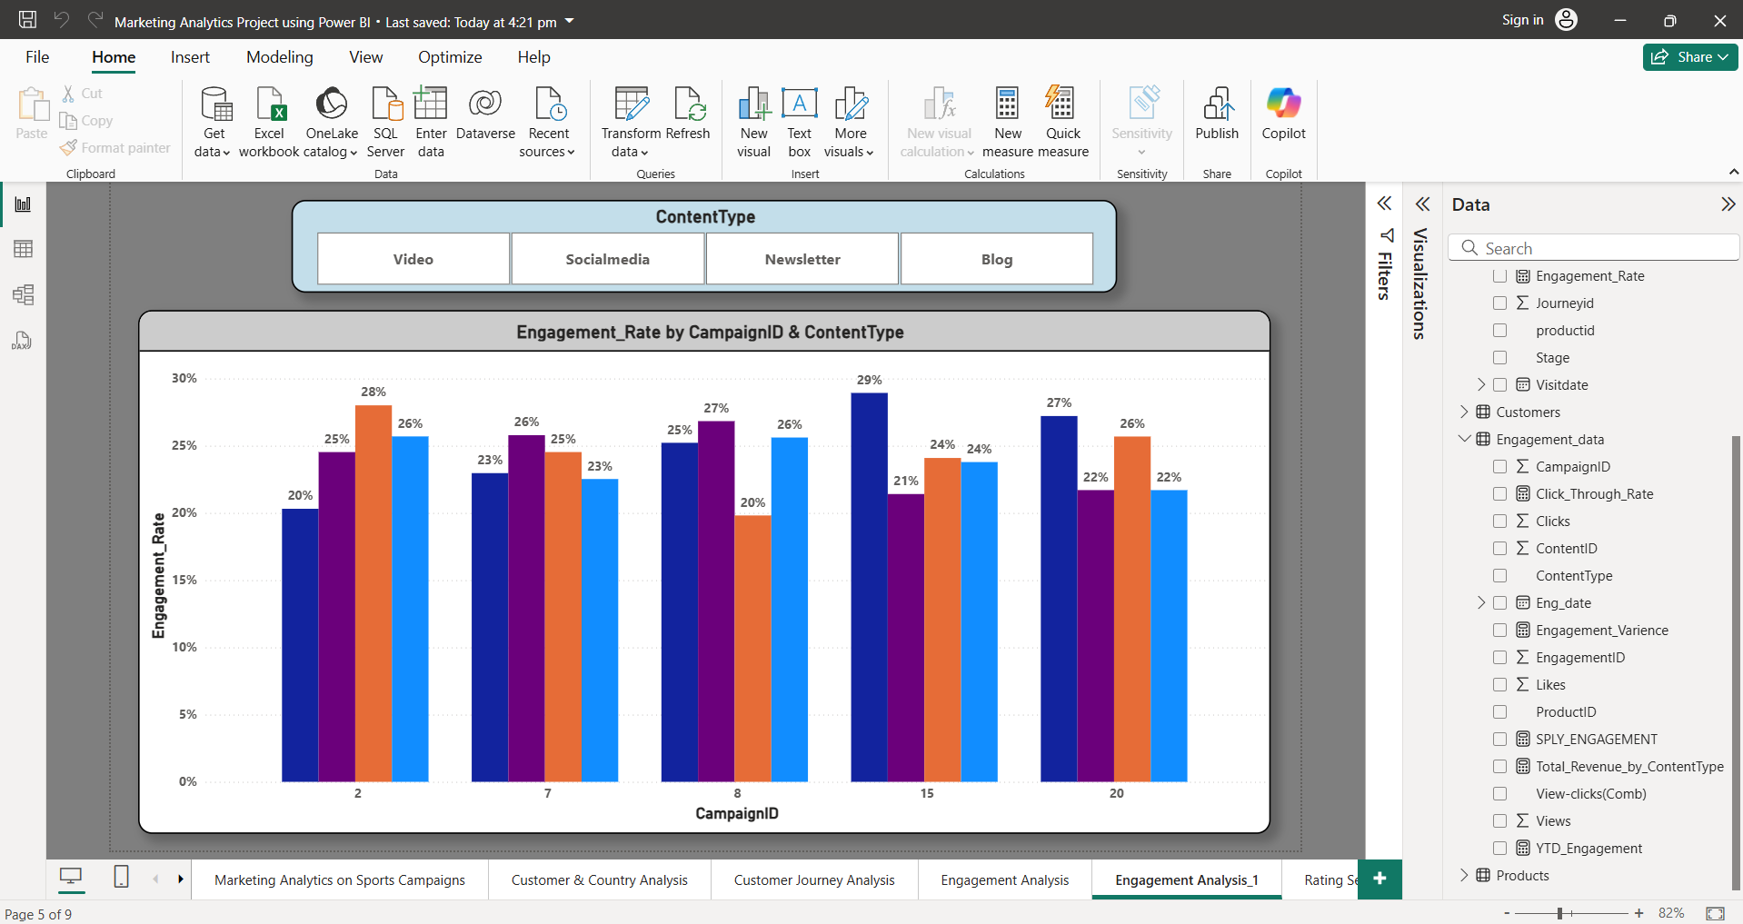
Engagement Analysis

Slide 31
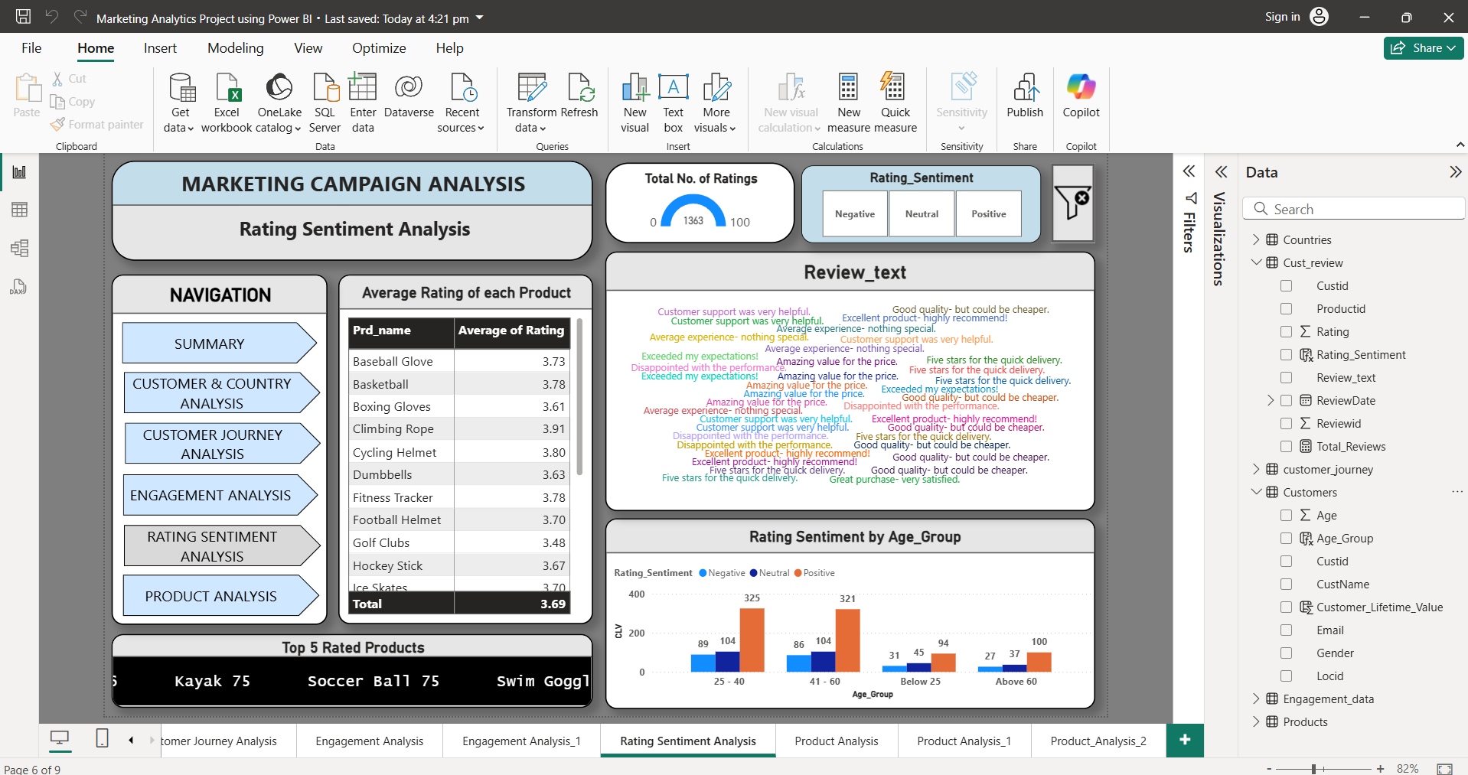
Rating sentiment Analysis

Slide 32
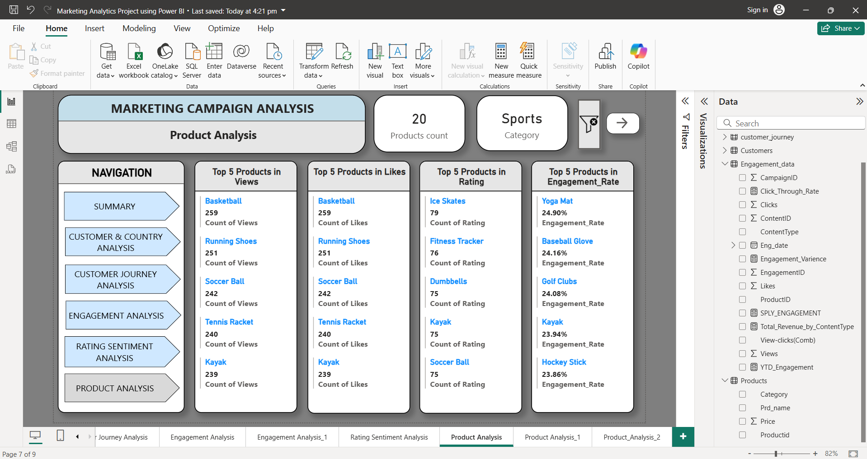
Project Analysis

Slide 33
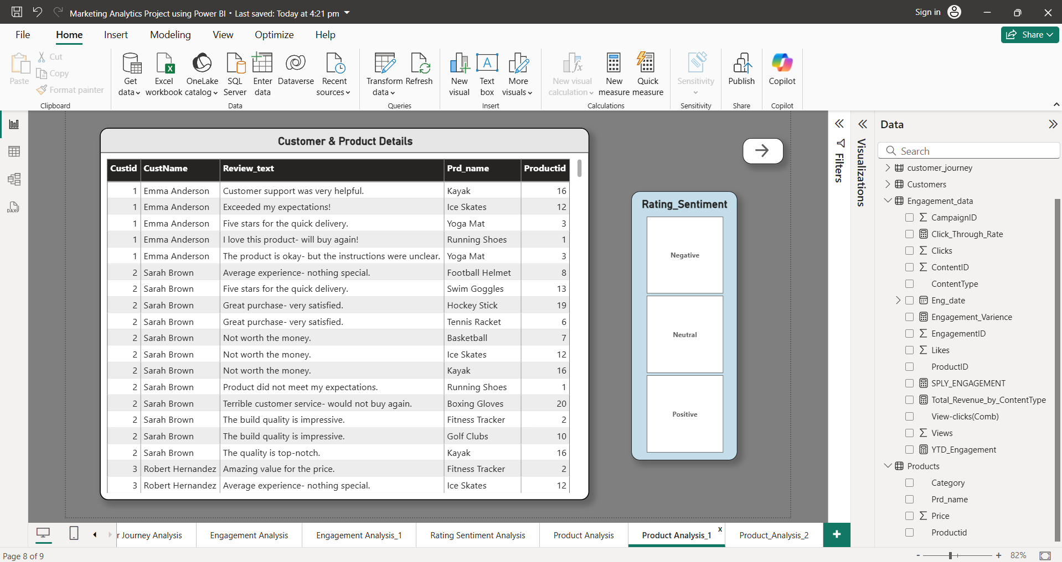
Project Analysis

Slide 34
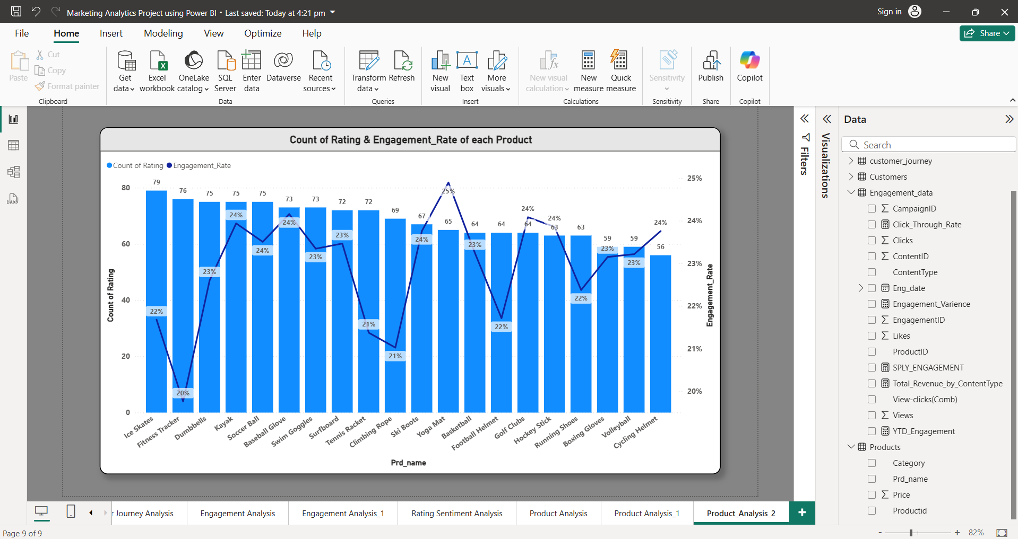
Project Analysis

Slide 35
RECOMMENDED ANALYSIS

Slide 36
RECOMMENDED ANALYSIS
Recommended Analysis refers to the Areas that needs deeper Exploration or further Study to uncover hidden Trends, Patterns, or Optimization opportunities.
Analyse Customer Engagement by Campaign and Age_Group & Gender.
Monitor Drop-offs on specific Journey Stages like Checkout.
Track which Content Types (Blog, Video, Newsletter) gives best Conversion_Rate.
Understand how Clicks, Views, Conversion Rate, and Ratings change over Time. (weekly/monthly).
Which Campaigns perform well over Time.
Understand if Highly Rated Products are also Highly Engaged with.

Slide 37
Trends
Customer Demographics Trend
Customers Aged 25-40 have the Highest Conversion_Rate and Positive Rating Sentiment, making them the Most Satisfied and Engaged group.
The Average Rating across all Products is 3, showing Moderate overall Customer Satisfaction.
Trend : Customers Aged 25–40 show the Highest Engagement and Satisfaction levels.
Product Engagement Trend
Basketball consistently ranks highest in Clicks, Likes, and Views, showing it’s the most popular Product.
Surfboard ranks lowest across all Engagement Metrics, indicating low interest.
Trend : There is a Clear preference for team sports like Basketball, while Seasonal Products like Surfboards receive significantly Less Engagement.
Campaign Trend
All Campaigns target only the Sports Category, reflecting a narrow promotional strategy.
Campaign ID 15 performs the Best in Engagement, while Campaign ID 10 performs the Least.
Trend : Marketing efforts are heavily focused on one Category.

Slide 38
RECOMMENDATIONS

Slide 39
RECOMMENDATIONS
Recommendations are the Actionable Suggestions based on current Findings, aimed at Improving future Performance and Strategy.
Focus marketing on Customer’s Gender with Higher CLV since Females contributes More CLV than Males.
Focus Marketing on the 25–40 Age Group shows High Conversion_Rate and Positive Rating Sentiment.
Optimize Checkout Experience High Drop-off at the Checkout Stage signals friction.
Push Highly Rated Products through Blog and Video content Types.
Improve Performance of Low-Engaging Products like Surfboard and Fitness Tracker.
Highlight Positive Ratings of Products like Ice Skates in marketing content.
Refine Campaigns with Poor Performance (e.g., ID 10, 19, 1) by Leveraging strategies from Top performing efforts like Campaign 15.
Monitor Sentiment over time to track Brand perception & Seasonality.
Use Time-Based Promotions Identify peak engagement periods and launch campaigns during those times.

Slide 40
THANK YOU

